Slide 1

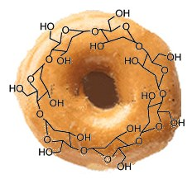
Πανεπιστήμιο Κρήτης-Τμήμα Χημείας
Μάθημα:Υπερμοριακή Χημεία
Καθηγητής:Κουτσολέλος Αθανάσιος
Παρουσίαση
Κυκλοδεξτρίνες
Γιαννούδης Μάνος 869

Slide 2
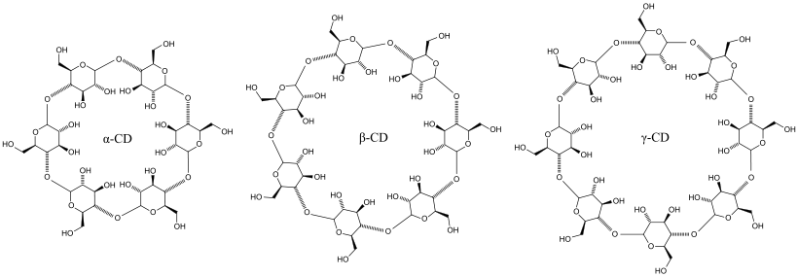
Cyclodextrines ????
Cyclodextrins (sometimes called cycloamyloses) are family of cyclic oligosaccharides composed of-a(1,4) linked glucopyranose units
They possess a cage-like supramolecular structure, which is the same as the structures formed from cryptands, calixarenes, cyclophanes, spherands and crown ethers
Τhe majority of their reactions are of ‘host–guest’ type
Typical cyclodextrins contain a number of glucose monomers ranging from six to eight units in a ring, creating a cone shape:
α (alpha)-cyclodextrin: 6-membered sugar ring molecule
β (beta)-cyclodextrin: 7-membered sugar ring molecule
γ (gamma)-cyclodextrin: 8-membered sugar ring molecule

Slide 3
History
Historical period | Investigator | Event or achievement
1891 | A. Villiers | Discovery of α and β cyclodextrins
1903–1911 | F. Schardinger | Isolation of bacteria responsible for CD synthesis
1935 | K. Freudenberg | γCD is discovered
1950s | D. French F. Cramer | Discovery of CDs with larger rings
1976 | Ono Pharmaceutical Co. | Release of the first medicine, prostarmon E, from CD
1990s | A. Harada M. Kamach | Intensive research activity on CD catenanes and rotaxanes
2000s | M. Bonini A. Coleman G. Gonzalez-Gaitiano T. Loftsson L. Szente A. Wu | Intensive research activity on CD aggregation

Slide 4
Production of cyclodextrins
starch is liquified either by heat treatment or using α-amylase
CGTase is added for the enzymatic conversion
Treatment of starch with an enzyme called cyclomaltodextrin glucanotransferase, naturally excreted by Bacillus macerans gives a crude mixture of α-cyclodextrin (∼60%),β -cyclodextrin (∼20%) and γ-cyclodextrin (∼20%) together with small amounts of cyclodextrins with more that eight glucose units
Biotechnological advances (1970s) →dramatic improvements in their production
Genetic engineering →different types of CGTases

Slide 5
Chemical structure
As a result of this cavity, cyclodextrins are able to form inclusion complexes with a wide variety of hydrophobic guest molecules

Slide 6
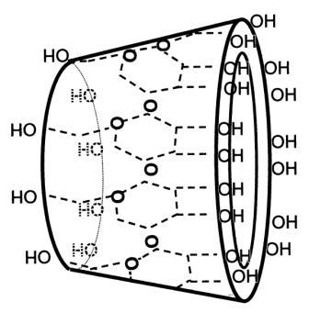
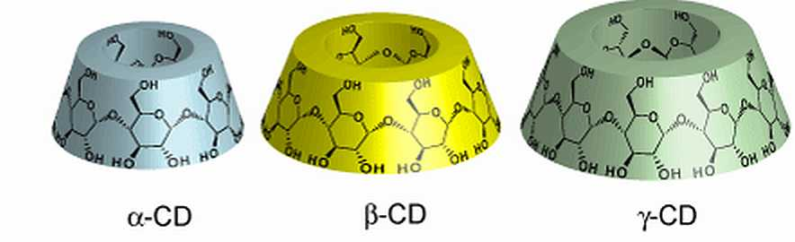
Toroids with the larger and the smaller openings of the toroid exposing to the solvent secondary and primary hydroxyl groups

Slide 7
Cyclodextrins properties
β-Cyclodextrin is the most accessible, the lowest-priced and generally the most useful
α-,γ- food industry

Slide 8
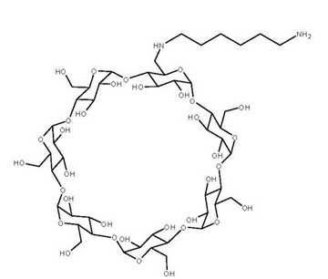
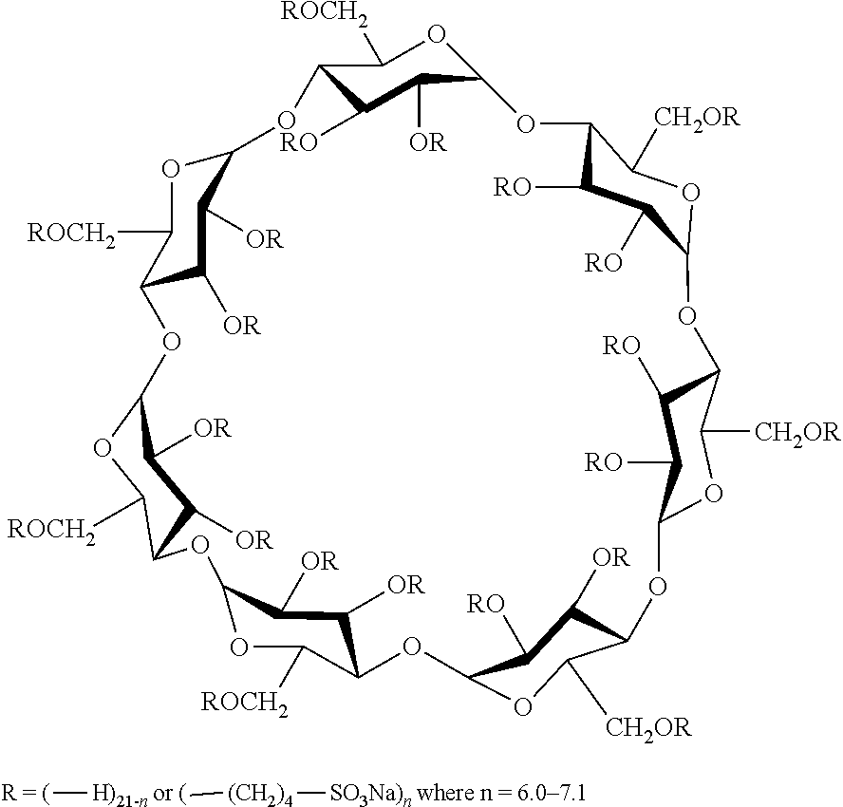
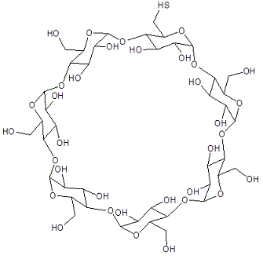
Cyclodextrin derivatives
aminations, esterifications or etherifications of primar and secondary hydroxyl groups of the cyclodextrins
changed hydrophobic cavity volume, improve solubility, stability against light or oxygen, control the chemical activity of guest molecules

Slide 9
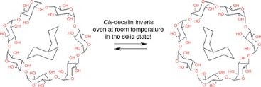
Inclusion complex formation
inclusion complexes (host–guest complexes) with a very wide range of solid, liquid and gaseous compounds
microenvironment into which appropriately sized non-polar moieties can enter to form inclusion complexes
No covalent bonds are broken or formed during formation of the inclusion complex
The potential guest list for molecular encapsulation in cyclodextrins is quite varied and includes such compounds as straight or branched chain aliphatics, aldehydes, ketones, alcohols, organic acids, fatty acids, aromatics, gases, and polar compounds such as halogens, oxyacids and amines

Slide 10
Inclusion complex formation
The ability of a cyclodextrin to form an inclusion complex with a guest molecule is a function of two key factors.
steric and depends on the relative size of the cyclodextrin to the size of the guest molecule or certain key functional groups within the guest
thermodynamic interactions between the different components of the system (cyclodextrin, guest, solvent)
four energetically favourable interactions that pulls the guest into the cyclodextrin
The displacement of polar water molecules from the apolar cyclodextrin cavity
The increased number of hydrogen bonds formed as the displaced water returns to the larger pool.
A reduction of the repulsive interactions between the hydrophobic guest and the aqueous environment.
An increase in the hydrophobic interactions as the guest inserts itself into the apolar cyclodextrin cavity

Slide 11
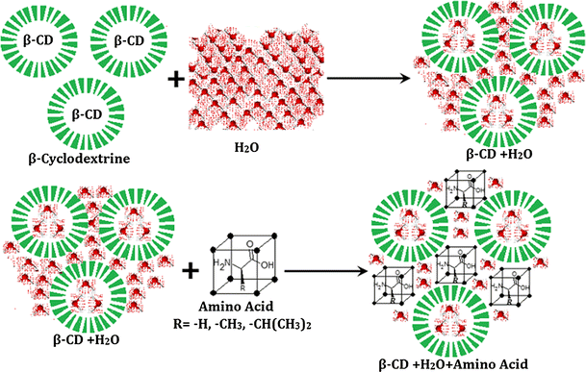

Slide 12
BENEFICIAL EFFECTS OF COMPLEXATION WITH CYCLODEXTRINS
Advantageous changes in the chemical and physical properties of the guest molecules.
Stabilisation of light- or oxygen-sensitive substances.
Modification of the chemical reactivity of guest molecules.
Fixation of very volatile substances.
Improvement of solubility of substances.
Modification of liquid substances to powders.
Protection against degradation of substances by microorganisms.
Masking of ill smell and taste.
Masking pigments or the colour of substances.
Catalytic activity of cyclodextrins with guest molecules.

Slide 13
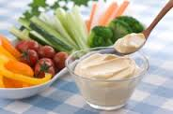

Applications
Food industry
stabilizers for flavoring agents
reduce unpleasant odor and taste
Cholesterol free products
Cosmetic industry
stabilizers of chemically labile compounds
prolonged action
decrease local irritation
reduce unpleasant odors

Slide 14
environmental protection:
immobilise inside their rings toxic compounds, like trichloroethane or heavy metals, or can form complexes with stable substances, like trichlorfon (an organ phosphorus insecticide) or sewage sludge, enhancing their decomposition
supramolecular chemistry
synthesize certain mechanically-interlocked molecular architectures, such as rotaxanes and catenanes

Slide 15
Pharmaceutical applications
Solubilize hydrophobic drugs used for drug delivery
penetrate body tissues → release biologically active compounds under specific conditions
a)pH change→ loss of hydrogen or ionic bonds between the host and the guest molecules
b)heating or action of enzymes→cleave α-1,4 linkages between glucose monomers
Sugammadex, a modified γ-cyclodextrin which reverses neuromuscular blockade by binding the drug rocuronium
2. Ternary complexes:
Drug/CD/metal ion
Drug/CD/organic ion
Drug/CD/polymer
Drug1/CD/drug2
Drug/CD1/CD2
Drug/CD/liposomes

Slide 16
Pharmaceutical applications

Slide 17
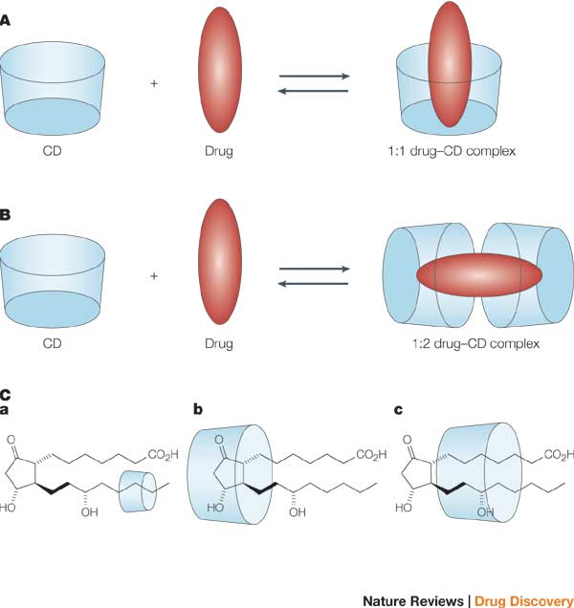

Slide 18
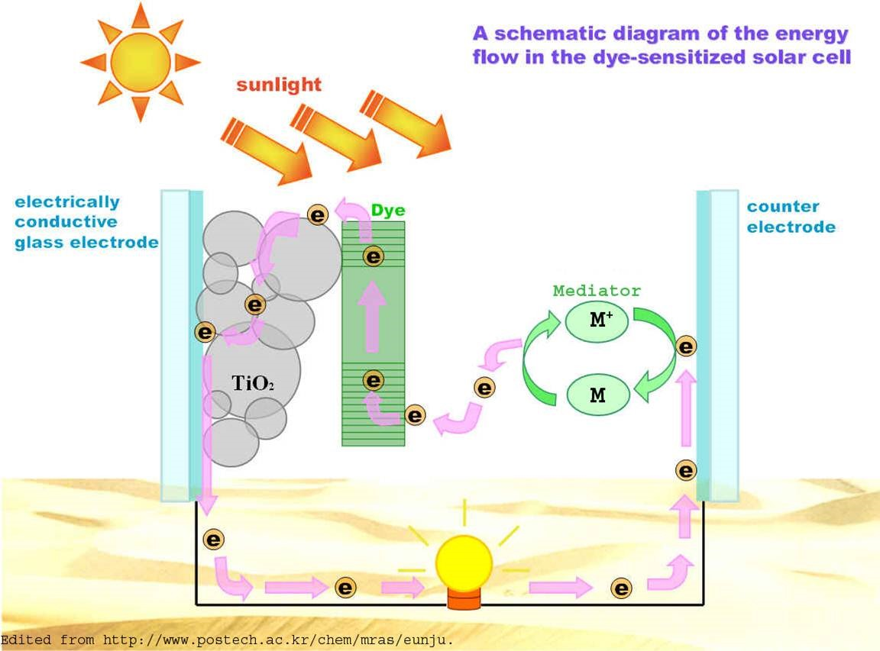
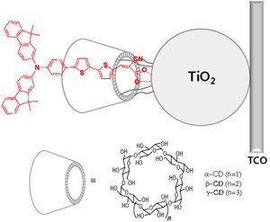
Dye-Sensitized Solar Cell

Slide 19
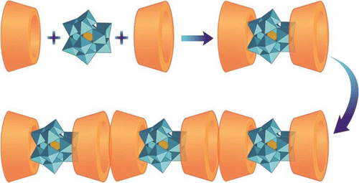
Complexation of Polyoxometalates with Cyclodextrins
complexation between γ- and β-cyclodextrins (γ- and β-CDs) with an archetype polyoxometalate (POM) the [PMo₁₂O₄₀]⁻ᵌ
(CD-POM-1)
(CD-POM-2)

Slide 20
References
An Efficient Dye-Sensitized Solar Cell with an Organic Sensitizer Encapsulated in a Cyclodextrin Cavity** Hyunbong Choi, Sang Ook Kang, Jaejung Ko,* Guohua Gao, Hong Seok Kang, Moon-Sung Kang, Md. K. Nazeeruddin, and Michael Grtzel
Cyclodextrins and their pharmaceutical applications Thorsteinn Loftsson a,∗, Dominique Duchˆene b
Review Cyclodextrins and their uses: a review E.M. Martin Del Valle
Cyclodextrins Sergey V. Kurkov,Thorsteinn Loftsson
Properties and Applications of Cyclodextrins Wen J. Shieh & A. R. Hedges
Complexation of Polyoxometalates with Cyclodextrins Yilei Wu, Rufei Shi, Yi-Lin Wu, James M. Holcroft, Zhichang Liu, Marco Frasconi, Michael R. Wasielewski, Hui Li, and J. Fraser Stoddart

Slide 21

ΣΑΣ ΕΥΧΑΡΙΣΤΩ ΠΟΛΥ ΓΙΑ ΤΗΝ ΠΡΟΣΟΧΗ ΣΑΣ!!!!

